Slide 1
Airbnb Bookings Analysis

Slide 2
Content :
1) Introduction.
2) Data Exploration.
3) Missing value Handling.
4) Exploratory Data Analysis.
Univariate Analysis.
Multivariate Analysis.
5) Conclusion.

Slide 3
Introduction.
Since 2008, guests and hosts have used Airbnb to expand on traveling possibilities and present a more unique, personalized way of experiencing the world.
Today, Airbnb became one of a kind service that is used and recognized by the whole world.
Data analysis on millions of listings provided through Airbnb is a crucial factor for the company.
These millions of listings generate a lot of data - data that can be analyzed and used for security, business decisions, understanding of customers' and providers' (hosts) behavior and performance on the platform, guiding marketing initiatives, implementation of innovative additional services and much more.
This dataset has around 49,000 observations in it with 16 columns and it is a mix between categorical and numeric values

Slide 4
Data Exploration
There are 16 columns and 48895 rows present in dataset.
This dataset has around is mix between categorical and numeric values.
Price is a dependent column.
Min of Price variable is 0, max is 10000$.
Mean price is 152.72 $
On an average people stay 7 days in a room.
75 Percentage of times minimum nights stayed is 5.
Mean reviews given to Room/apartment is 23.

Slide 5
Missing value Handling.
‘name’ = 16 Missing values.
‘host_name’ = 21 missing values.
‘last_review’ = 10052 missing values.
‘reviews_per_month’ = 10052 missing values.
‘name’ column we will replaced the ‘missing’ values by the use of fillna().
‘host_name’ will replaced the ‘missing’ values by use of fillna().

Slide 6
Exploratory Data Analysis

Slide 7
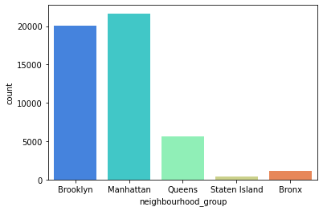
neighbourhood_group
Most of the hosts are in Manhattan and Brooklyn

Slide 8
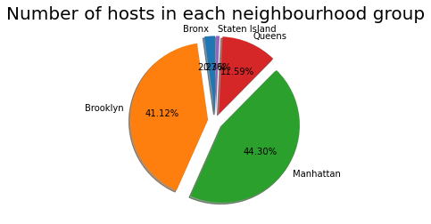
Here we can see Manhattan has 44.30% hosts.

Slide 9
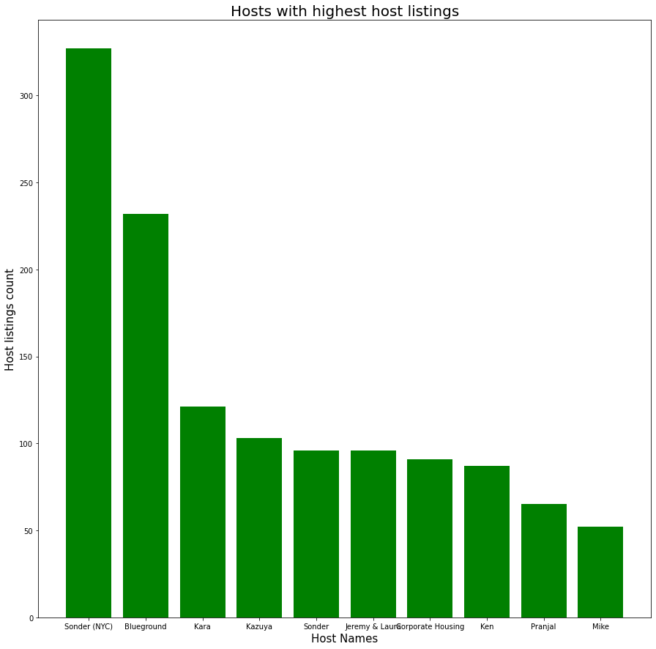
Host with Highest Host listings
The host Sonder(NYC) has the highest listings of 327

Slide 10
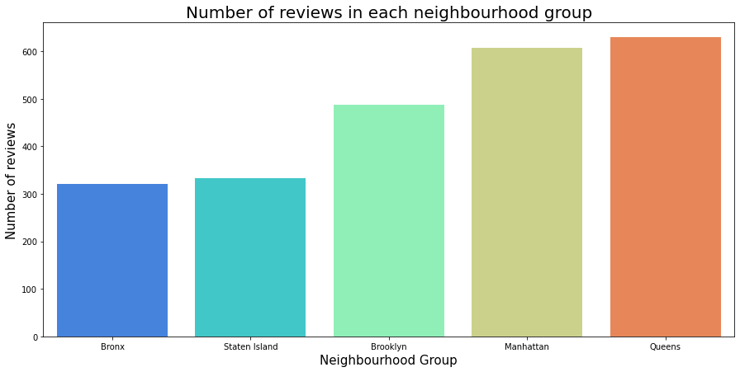
Most of the people likes Queens and Manhattan

Slide 11
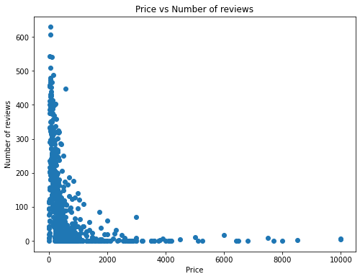
Price vs Number of reviews
Most of the guests prefer cheaper price.

Slide 12
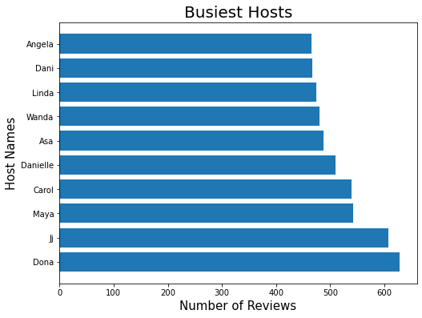
Busiest Hosts
Dona and Ji are the busiest hosts.

Slide 13
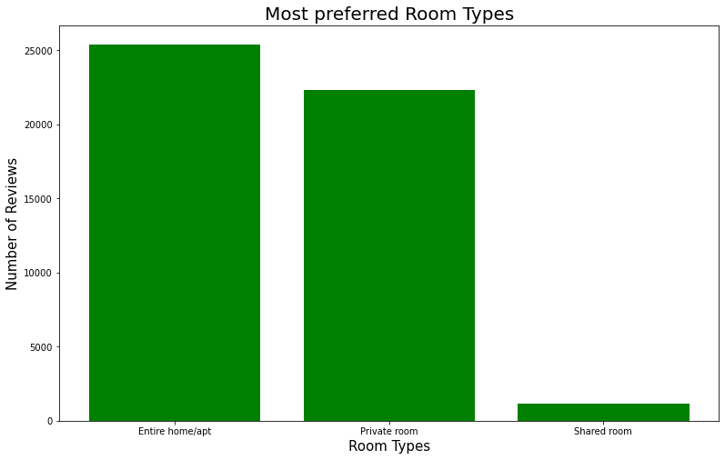
Room Types
There are 3 types of rooms i.e.
1. entire home/apt,
2. Private room,
3. Shared room.
From graphs, we could clearly see that entire home/apt and private room are the most preferred room types.
Many few peoples like to share room.

Slide 14
Multivariate Analysis

Slide 15
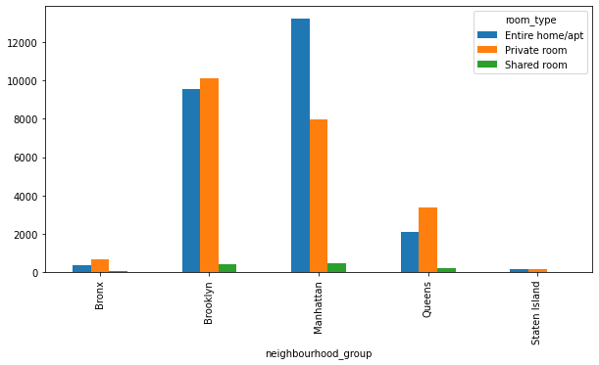
Neighbourhood Group vs Room type
Above plot shows the comparision of neighbourhood_ group with the room type.

Slide 16
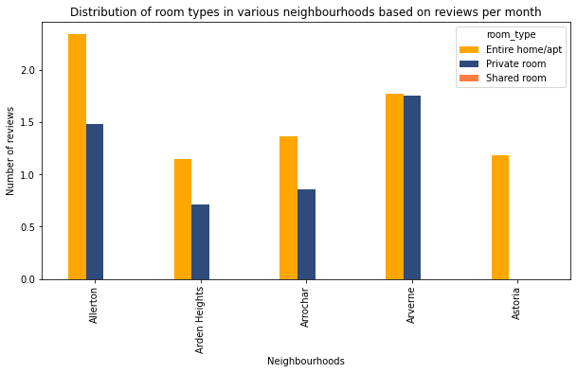
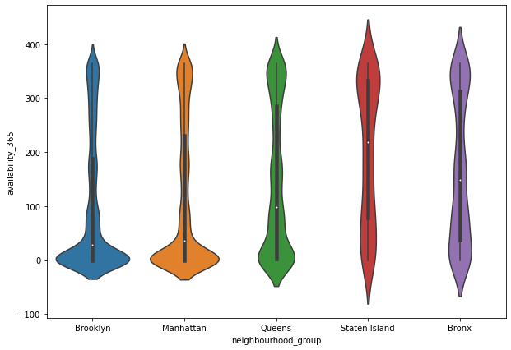
Price range varies from different room type, as expected shared room have high price range. Private rooms and shared rooms price range are more centered around their mean.
Violin Plot shows that Staten Island has the highest mean availability value around 220-250 days compared to others

Slide 17
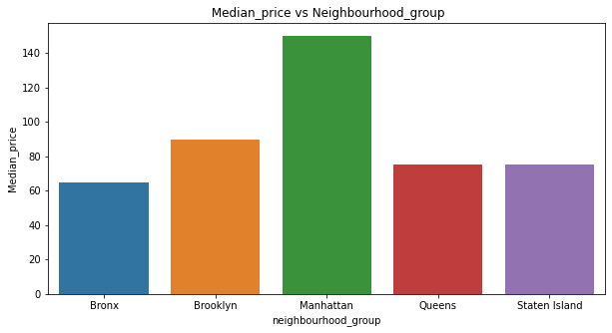
Median Price vs Neighbourhood Group
Manhattan' is the area having highest median price, followed by Brooklyn.

Slide 18
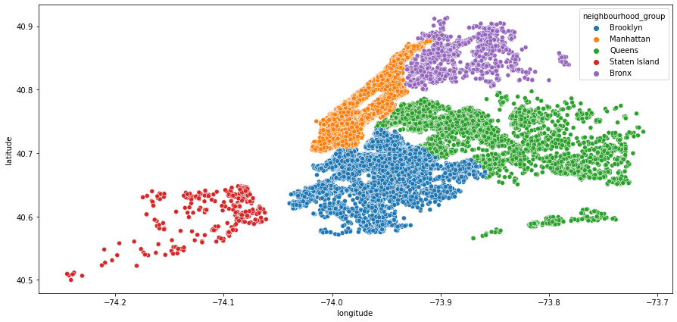
Latitude & Longitude

Slide 19
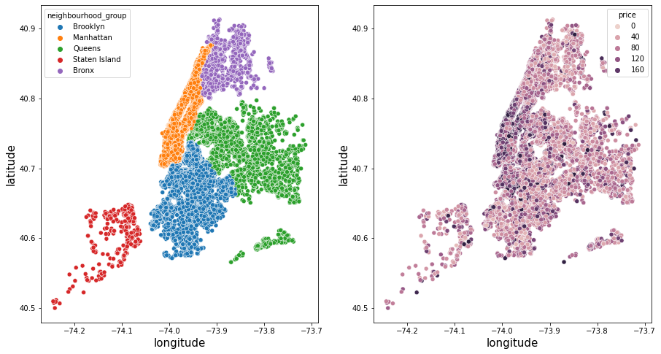
Latitude & Longitude

Slide 20
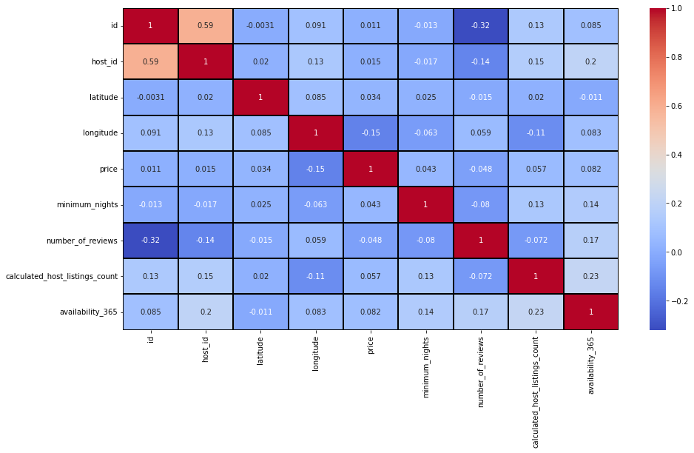
Correlation of Features

Slide 21
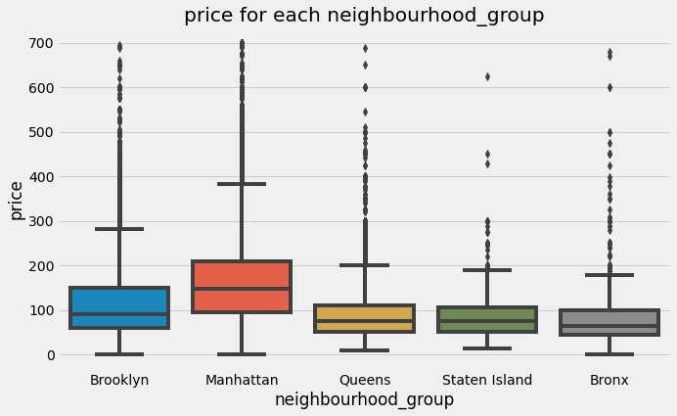
Price for Each Neighbourhood Group
We can see that Manhattan is the most expensive destination immediately followed by Brooklyn.
Queens, Staten island and Bronx, are having price range less as compared to other two.

Slide 22
Conclusion
80% of the hosts are in Manhattan and Brooklyn
Sonder(NYC) and Blue ground has most number of host listings
Most of the people likes Queens and Manhattan
Even with moderate number of hosts in Queens, it generated the highest revenue out of all the neighborhood group
Most of the guests prefer cheaper price
Dona and Ji are the busiest hosts
About 90% of the guests prefer entire home/apt or private room room types.
Thank You!

